Slide 1
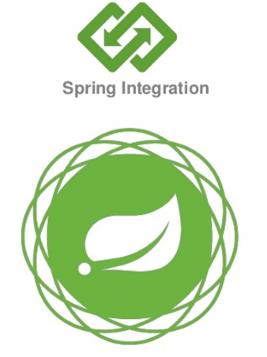
Spring Integration

Slide 2
Spring Integration
It is lightweight framework which provide
Messaging within Spring-based applications
It supports message-driven architectures (pipes and filters architectural) where inversion of
control applies to runtime concerns, such as when certain business logic should execute and
where the response should be sent.
Integration with external systems via declarative adapters.
Those adapters provide a higher-level of abstraction over Spring’s support for remoting, messaging, and scheduling.

Slide 3
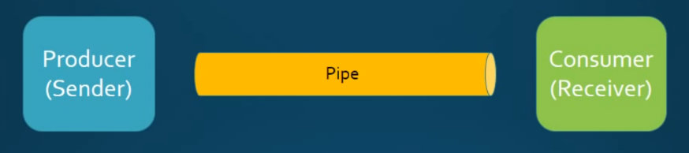
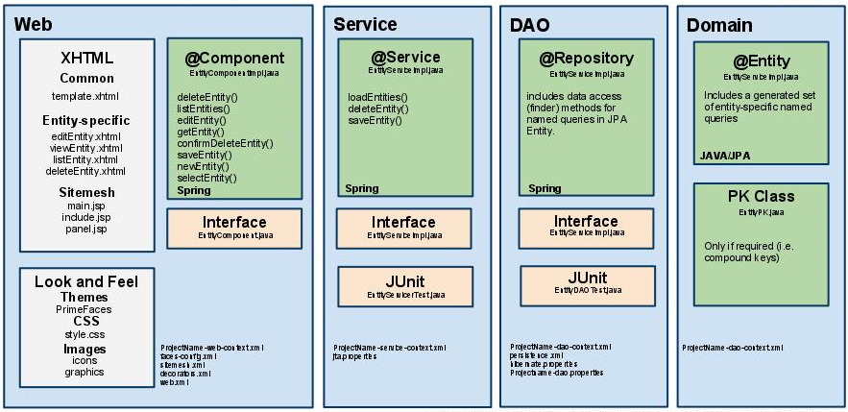
Horizontal Perspective (Message-driven architectures)
Vertical perspective (Layered architecture)

Slide 4
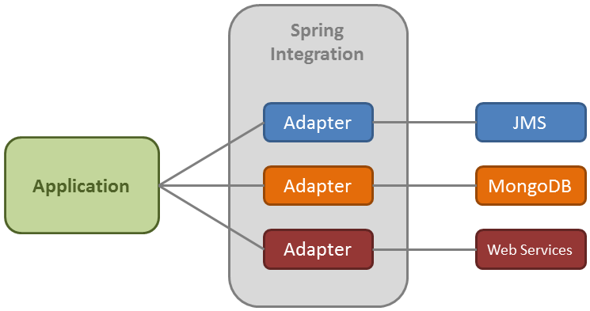
Integration with external systems via declarative adapters.
Those adapters provide a higher-level of abstraction over Spring’s support for remoting,
messaging, and scheduling.
Primary goal is to provide a simple model for building enterprise integration solutions while
maintaining the separation of concerns that is essential for producing maintainable, testable code

Slide 5
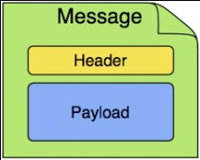

Spring Integration Components
01
Pipes are called Channels
02
Endpoints
Producers and Consumers
Communication are occurred
through Messages.
03

Slide 6
Pollable Channel
Message Channel
Subscribable Channel
Message Endpoint
Transformer
Service Activator
Filter
Channel Adaptors
Splitter
Messaging Gateway
Aggregator
Router

Slide 7
Adapters
Spring Integration comes with a number of built-in adapter
Stream Adapters (like Standard Input and Output stream adapters)
FTP and Secure FTP (SFTP) Adapters
File Adapters,
JMS Adapters,
JDBC and JPA Adapters,
Twitter Adapters
Feed (RSS, Atom, etc) Adapters,
Mail Adapters,
UDP Adapters

Slide 8
Reading a File From Unix Server
-----------Input Channel----------
--------Output Channel--------
Producer
Consumer
Poll the file using SFTP Adaptor
UTF-8
Inbound Channel Adaptors
Transformer
Service Activator

Slide 9
Thank you

